Slide 1
OIS 6660
Adam Tidwell
11/4/15

Slide 2

Agenda
Introduction
Syllabus review
Quiz
Lecture
Group project
CAPM/PMP Preparation
Notes:
Overview of the first class.

Slide 3
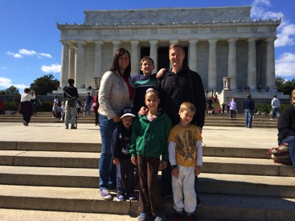
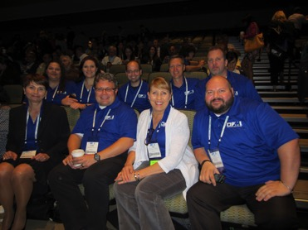
Introduction
Instructor: Adam Tidwell, PMP, PMI-ACP
Manager Project Management, eBay
President, PMI Northern Utah Chapter
Class introductions
Industry
Project management experience
Types of projects and methodologies
Notes:
Contact information for Adam Tidwell:
adamtidwell@mac.com
801-971-9300 (text or phone)
Response goal of 24 hours

Slide 4
Syllabus Review
Schedule review
Class outline
Grading
Notes:
Refer to syllabus for details…

Slide 5

Quiz
Practice
Not for credit
We will check them in class
Notes:
Quiz is to help students get acquainted with the testing format and types of questions asked before they study for a real quiz.

Slide 6
Lecture
PMBOK: Chapter 1-4
Notes:
Prepare slides for the appendix in the event that more details or supplemental slides are needed. The appendix is also useful if the presentation is distributed later.

Slide 7
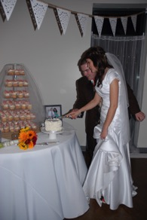


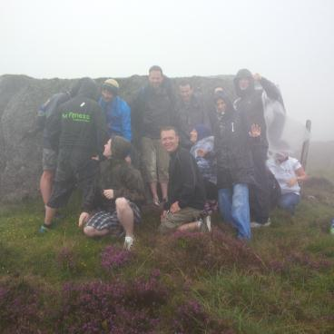
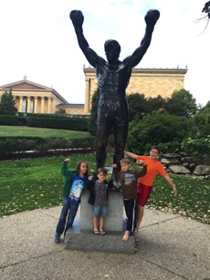



What is a project?
Why do we do projects?
Notes:
Definition of a project:
A temporary endeavor undertaken to create a unique product, service, or result.
Definite beginning and end.
It is not: ongoing work effort that is a repetitive process that follows an organization’s existing procedures.
Project Management is the application of knowledge, skills, tools, and techniques to project activities to meet the project requirements.
-PMBOK, 5th edition

Slide 8
Projects, Programs, and Portfolios
Portfolio- collection of projects, programs, sub-portfolios, and operations managed as a group to achieve strategic objectives.
Programs- a group of related projects, sub-programs, and program activities managed in a coordinated way to obtain benefits not available from managing them individually.
Broadband Infrastructure Portfolio
Rocky Mtn.
Wasatch Front
SLC
Ogden
Denver
Provo
CO Springs
Notes:
Portfolios – strategy and selecting the most beneficial projects for the organization’s objectives.
Programs – Aligning interdependencies between projects.
Projects – Single objective.

Slide 9
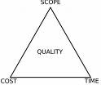
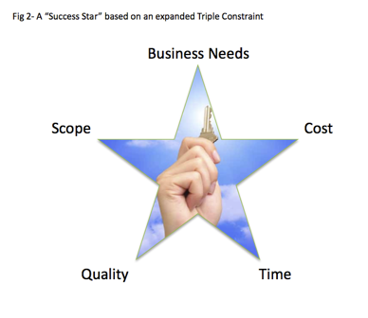
Project Management
Process Groups
Initiating- what should we do to reach our goal?
Planning- how do we do it?
Executing- do it.
Monitoring & Controlling- watch and adjust if necessary.
Closing- did we do it?
Constraints
Scope
Cost/Budget
Time/Schedule
Quality
Resources
Risks
Notes:
Process groups indicate the basic groups of activities that you will go through when working on a project.
Constraints:
Triple constraint- scope, cost, time
Additional- quality
Success Star- adds business needs (are we doing the right projects) to the equation
From "Triple Constraint" to "Success Star"?
From the Project Management 2.0 Blog
by Dave Garrett

Slide 10




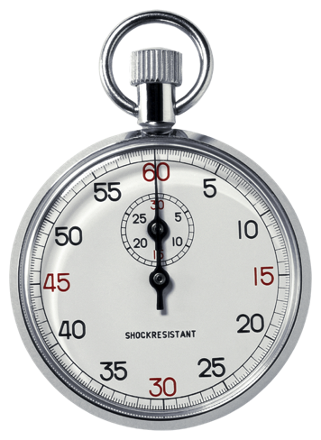




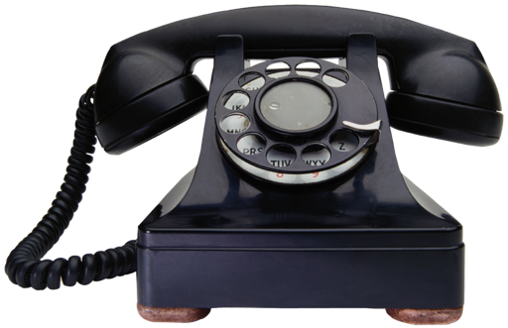
What do Project Managers do?
Notes:
Summary: responsible for successfully completing the project.
Project team: completing specific tasks (not meeting attenders).
Leads the team responsible for results
Planning
Communication
Motivation
Decision making
Negotiation
Conflict management
Coaching

Slide 11
Project Management Office (PMO)
Notes:
There are conflicting views about what a PMO is.
Losing popularity because success is not clear.
Sharing of best practices, methodologies, tools, and techniques
Liaison between projects, programs, and portfolios
Resource management
Planning and prioritization
Mentoring

Slide 12
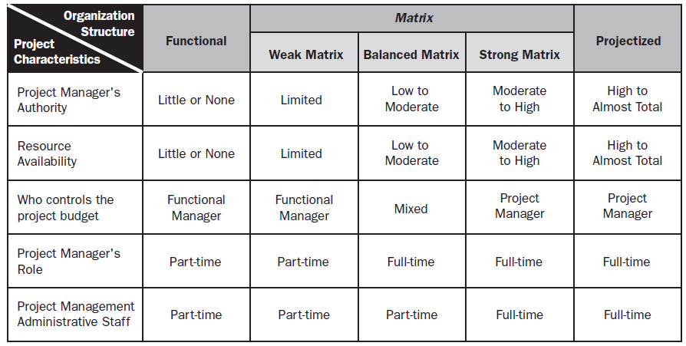
Organizational Structures
Source: PMBOK
Notes:
It helps to understand where your organization is to understand the whole matrix.

Slide 13
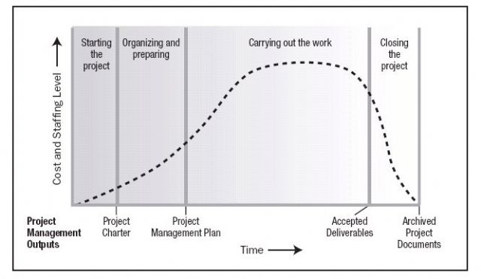
Project Life Cycle
Source: PMBOK
Notes:
Project Life Cycle:
Graphical representation of the typical cost and resources needed over time to complete a project.
Generally sequential.
Helps people know what you are working on.

Slide 14
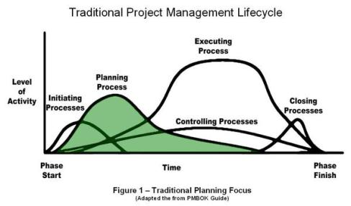
Project Management Processes Groups
Initiating
Planning
Executing
Monitoring & Controlling
Closing
Source: PMBOK
Notes:
Project Management Process Groups:
Groups of tools and techniques required to complete the project successfully.
Processes, tools, and techniques are flexible depending on the project (family vacation vs. construction of an airport).
Initiating- define project and gain approval
Planning- define details of scope, time, cost, etc.
Executing- do the work
Monitor & Control- make sure it is what you planned to do and make needed changes
Close- finish the work
5 process groups
47 processes
10 knowledge areas

Slide 15
Project Integration Management
Project Integration Management
Develop Project Charter
Develop Project Management Plan
Direct and Manage Project Work
Monitor and Control Project Work
Perform Integrated Change Control
Close Project or Phase
Notes:
Project Integration Management
Develop Project Charter- creating document that formally authorizes the project and provides authority for PM.
Develop Project Management Plan- defining, preparing, and coordinating all subsidiary plans into comprehensive Project Management Plan.
Direct and Manage Project Work- leading and performing the work defined in the Project Management Plan and implementing changes.
Monitor & Control Project Work- tracking, reviewing, and reporting progress towards objectives.
Perform Integrated Change Control- review change requests and communicate their status.
Close- finalize all activities
-PMBOK, 5th edition

Slide 16
Group Project
A real world project to practice the things you learn in class.
Notes:
Project must be initiated, planned, executed, monitored, controlled, and closed.
Doesn’t have to be big.
Examples:
Quilt tying for homeless shelter
Helping with a company food drive
Passing out flyers for a charity event
Turkey Bowl for kids in the neighborhood

Slide 17
Group Project Requirements
Real project to be completed
Documents to be turned in as 1 pdf file:
Charter
Timeline
Budget
Quality Management Plan
HR Plan
Communications Plan
Risk Management Plan
Procurement Management Plan
Stakeholder Register
Closing Documents
Not everyone has to participate in every activity, but responsibilities must be spread as evenly as possible.
Group presentation: 20 minutes each, which includes 5 minutes for questions.
Notes:
Real project to be completed before the last day of class.
Please contact me if there are members of your group that are not pulling their weight.
I will ask the whole group how they would grade your participation in the project and I will make a final judgment on how this will impact the grade for the project.
Each student is responsible for making sure they are doing something meaningful for the project.
*Part of this exercise mirrors the real world need to work together, communicate, lead, and come together as a project team.

Slide 18
Preparing for the PMP/CAPM Exam
Notes:
Prepare slides for the appendix in the event that more details or supplemental slides are needed. The appendix is also useful if the presentation is distributed later.

Slide 19
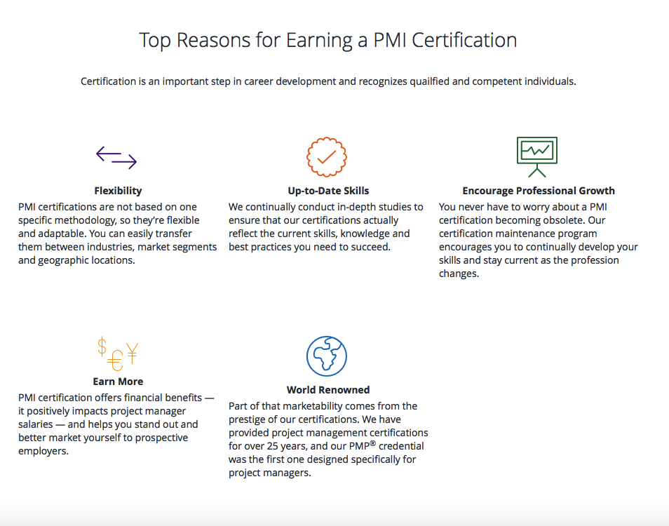
Notes:
www.pmi.org > Certifications
Flexibility: construction, IT, Customer Experience, etc.
Up to date skills: updated materials (PMBOK 5th edition)
Professional growth: PDUs required to renew certification
Earn more: US non PMP vs. PMP = $91,500 vs. 110,000 (+20%) PMI 2013 Salary Survey
World renowned: while most PMI members are in NA, significant growth in South America and Middle East.

Slide 20
Requirements to Take the PMP Exam
The PMP recognizes demonstrated competence in leading and directing project teams. If you’re an experienced project manager looking to solidify your skills, stand out to employers and maximize your earning potential, the PMP credential is the right choice for you.
A secondary degree (high school diploma, associate’s degree, or the global equivalent)
At least five years of project management experience, with 7,500 hours leading and directing projects and 35 hours of project management education.
OR
A four-year degree (bachelor’s degree or the global equivalent)
At least three years of project management experience, with 4,500 hours leading and directing projects
35 hours of project management education
PMP Handbook
Notes:
www.pmi.org
The 23 hours of project management education is satisfied by this class (ask for a completion letter).

Slide 21
Requirements to Take the CAPM Exam
PMI’s Certified Associate in Project Management (CAPM)® is a valuable entry-level certification for project practitioners. Designed for those with little or no project experience, the CAPM® demonstrates your understanding of the fundamental knowledge, terminology and processes of effective project management.
A secondary degree (high school diploma or the global equivalent)
AND
At least 1,500 hours of project experience
OR
23 hours of project management education by the time you sit for the exam.
CAPM Handbook
Notes:
Pmi.org
The 23 hours of project management education is satisfied by this class (ask for a completion letter).

Slide 22
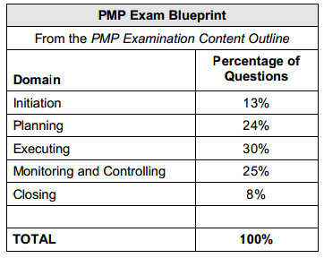
What is the Exam Like?
200 questions (175 scored)
4 hours to complete
Take nothing with you
Computer based
What is the “best” answer
Notes:
Hard, but not impossible.
Must apply and get approval to take the test.
$405 for PMI members to take the test.
Prometric testing center

Slide 23
How to Study for the Exam
PMBOK
Alternate books: Rita Mulcahy, PMP Exam Prep, 8th Edition
Mind maps
Formulas
Notes:
It will require studying outside of the regular classwork.
This class will be taught in a way that it will assist you if you are taking the test.
The last hour to half hour of class will be sharing best practices and doing test prep questions.

